Slide 1

Exploring Covid-19 Group 4

Slide 2
Project core message/hypothesis
Vaccinations will decrease the impact the COVID-19 virus has on outcomes

Slide 3
Questions of interest:
What are the latest COVID-19 case numbers by country?
What is the relationship between new COVID-19 cases and deaths observed in different countries?
What is the relationship between vaccination rate and death, ICU and hospital admissions?
What impact does a country’s wealth have on vaccination rollout?
We wanted to look for the current scenario
We wanted to understand what impact COVID-19 has had on deaths worldwide
We wanted to investigate if data shows a decrease in these outcomes associated with vaccination rates
We wanted to understand the availability of the vaccines worldwide and if there a disadvantage for lower income countries

Slide 4
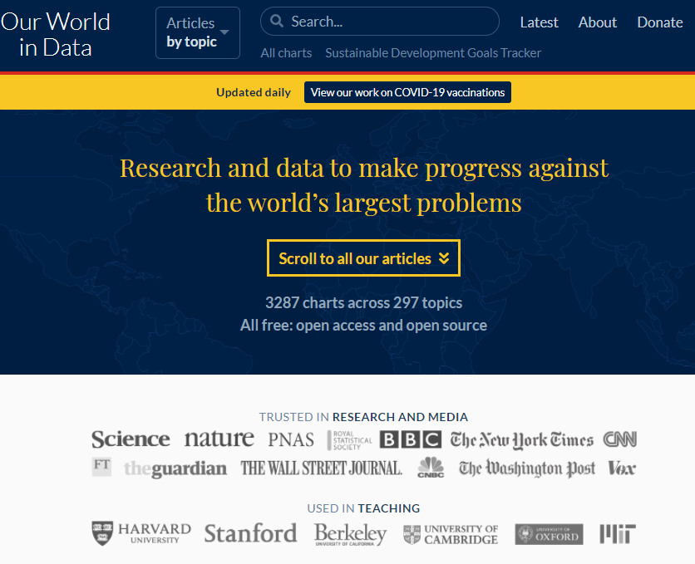
Summary of where and how we found the data to answer these questions
Searching for Covid-19 data on Google, we found the website ‘Our World in Data’ (https://ourworldindata.org/)
https://github.com/owid/covid-19-data/tree/master/public/data

Slide 5
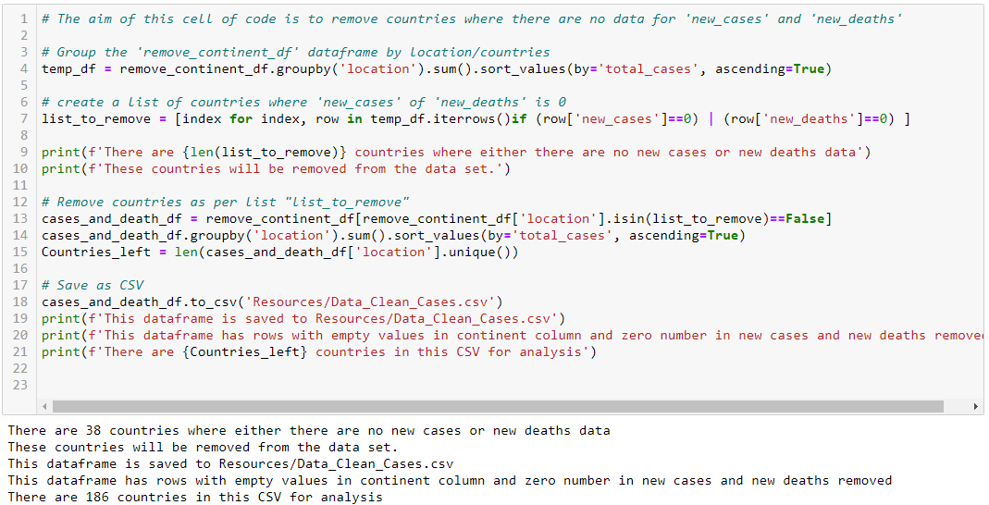
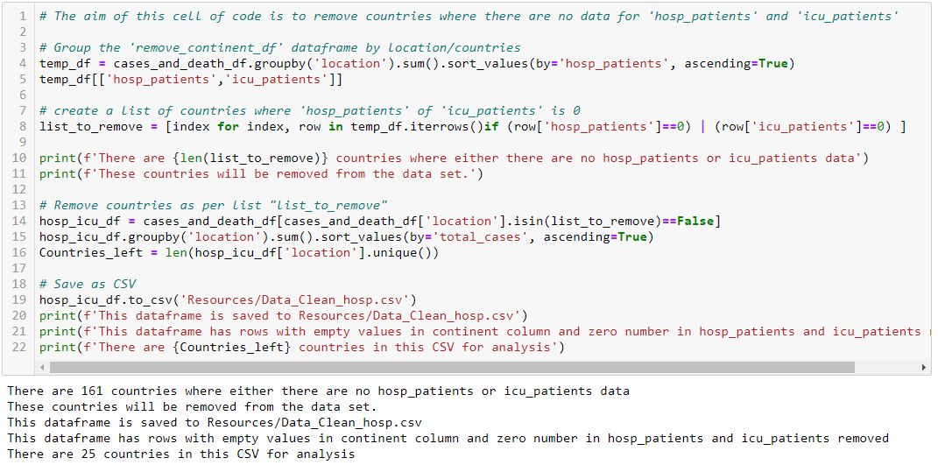
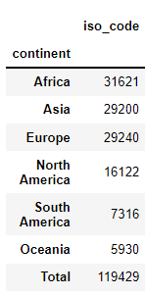
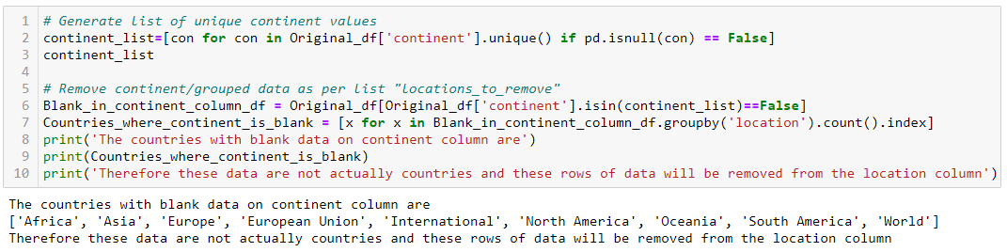
Data preparation and cleanup process
Dataset downloaded on 25/10/2021 with 125097 rows, 65 cols
Grouped Data by continent as first pass
Therefore there are null data is continent column
Generate a list of countries where continent is null
Groupings/continents are removed from country column
Grouped by countries and removed countries without new cases or new deaths data and save as new csv
Grouped by hospital and icu patients for next analysis and countries without these data are removed. Also saved as new csv.
Totals don’t match

Slide 6
Analysis process

Slide 7
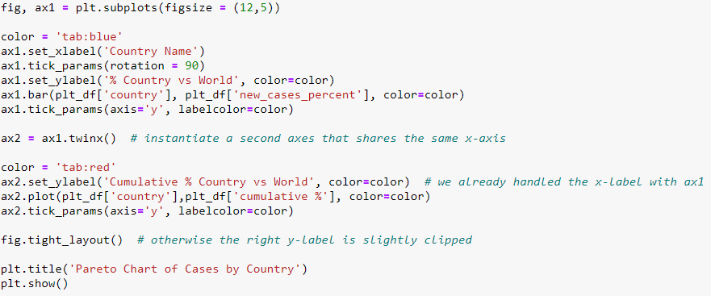
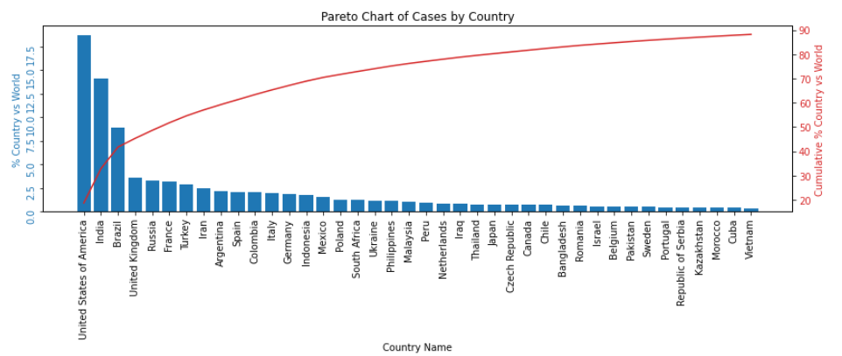
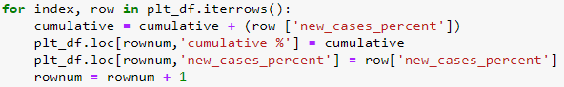
Q1: What are the latest COVID-19 case numbers by country?
Sum data by country
Sort from highest to lowest by cases
Create a new column in the dataframe and calculate cumulative cases
Plot both cases and cumulative on a single chart

Slide 8
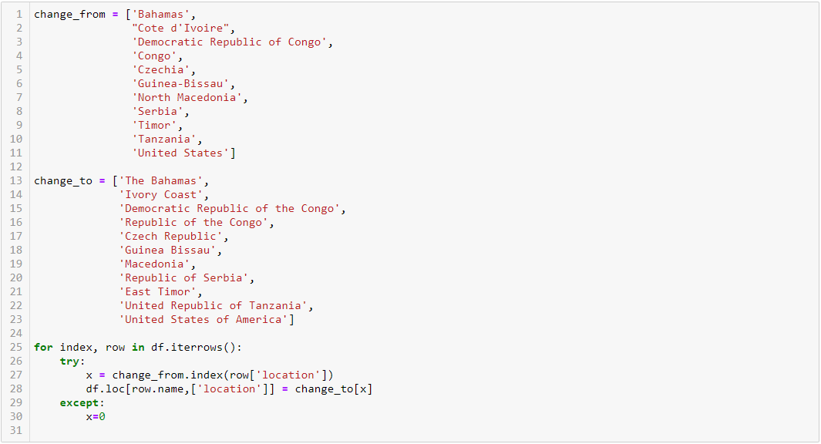
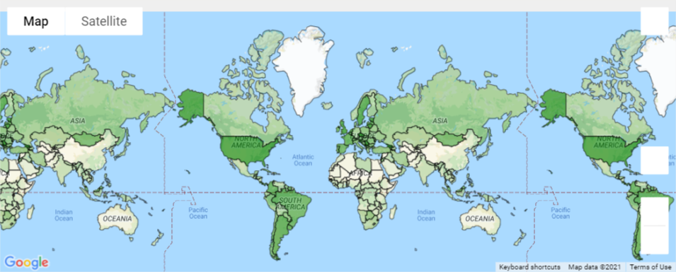
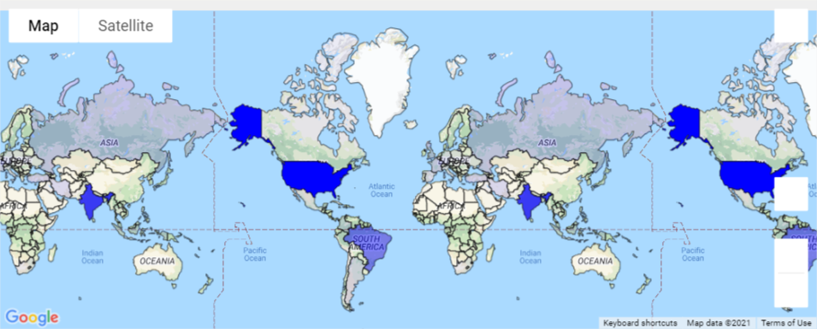
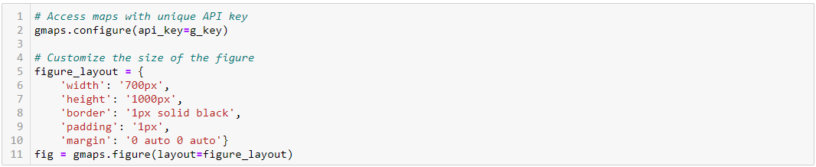
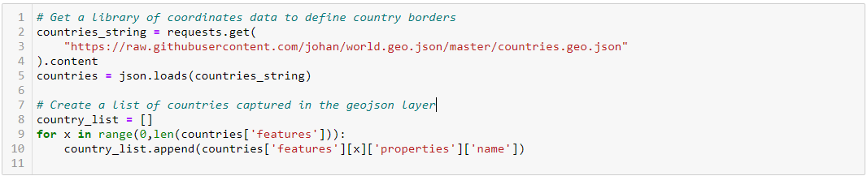
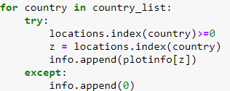
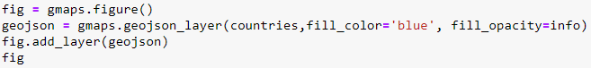
Visualising Cases on a map
Get API key and configure layout
Get country outline using geojson link from gmaps documentation
There are countries with 2 different names when comparing data to geojson layer. Created code to align.
Adjust cases on each country as a percentage of world
Make all values as a percentage of max to get more colour gradient
Create a list in the same order as the countries order as per geojson file
Plot
New chart shows the difference between analysing count vs count per million.
Cases by Count
Cases by Count per Million

Slide 9
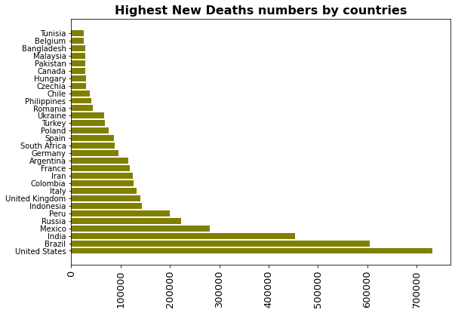
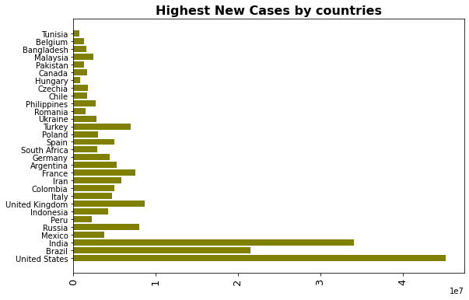
Q2: What is the relationship between new COVID-19 cases and deaths observed in different countries?

Slide 10
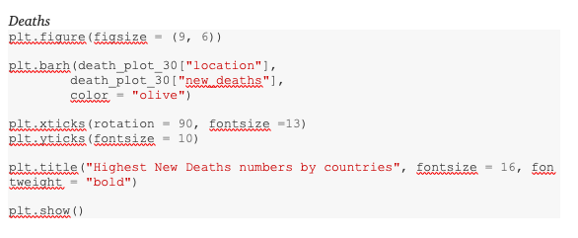
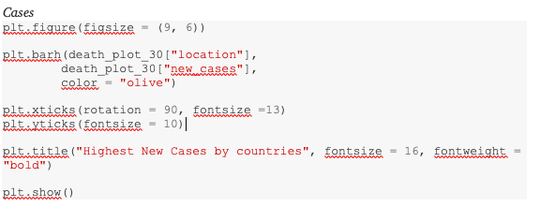
Python code - Matplotlib (Reference)

Slide 11
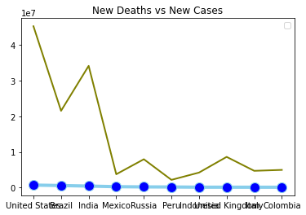
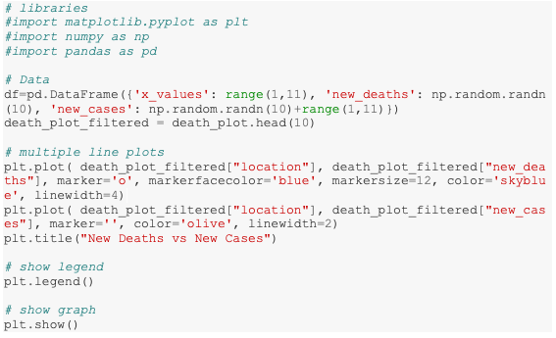
New deaths vs new cases

Slide 12
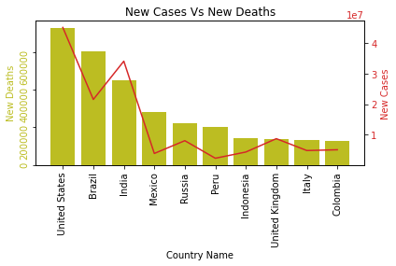
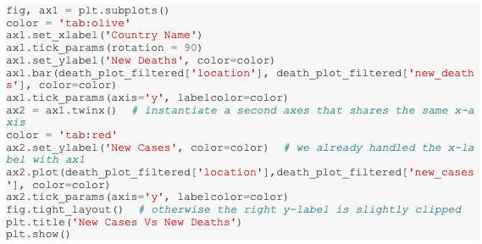
New cases vs new deaths

Slide 13
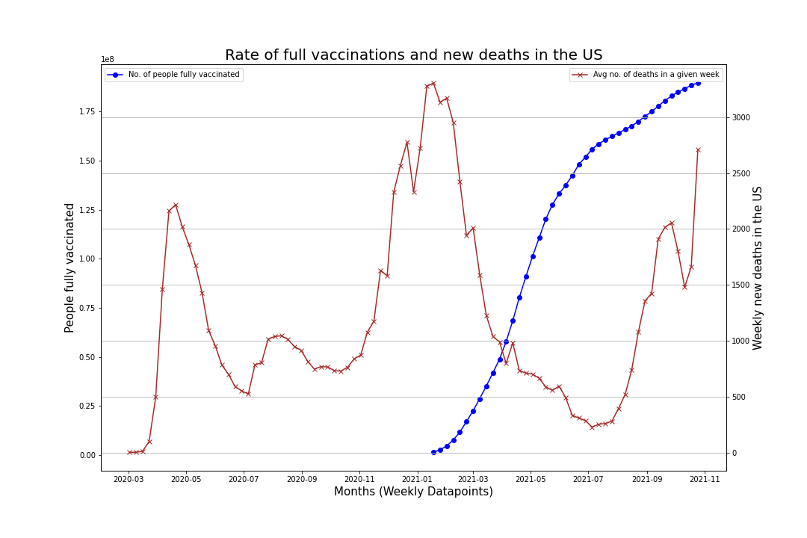
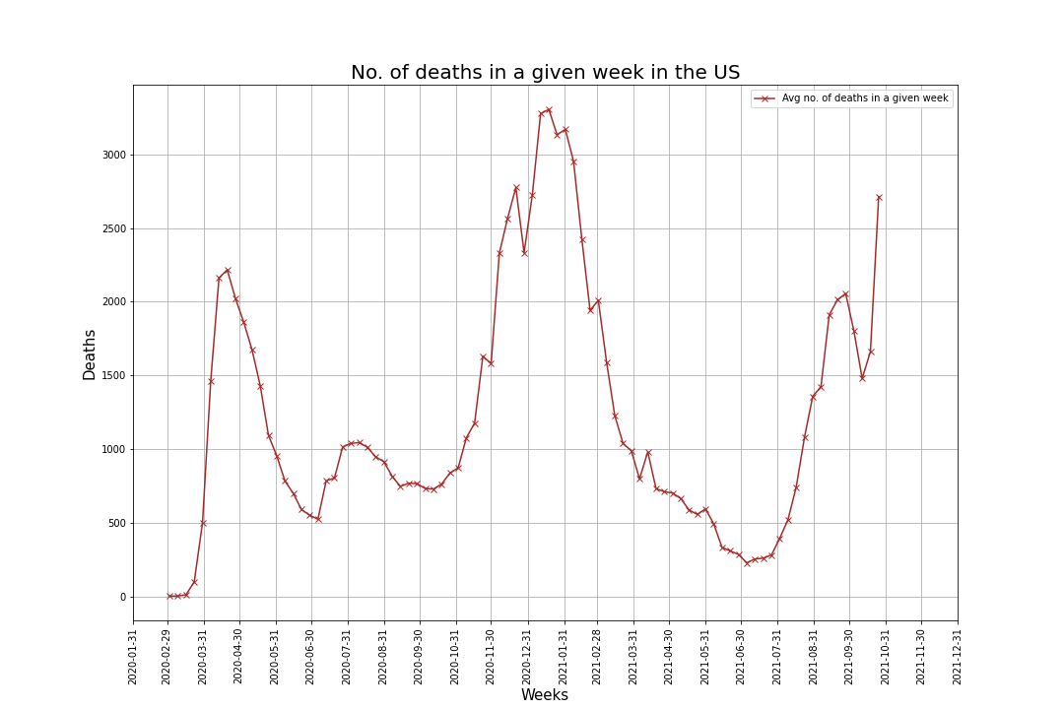
Q3: Time series plot for deaths and fully vaccinated people in the US

Slide 14
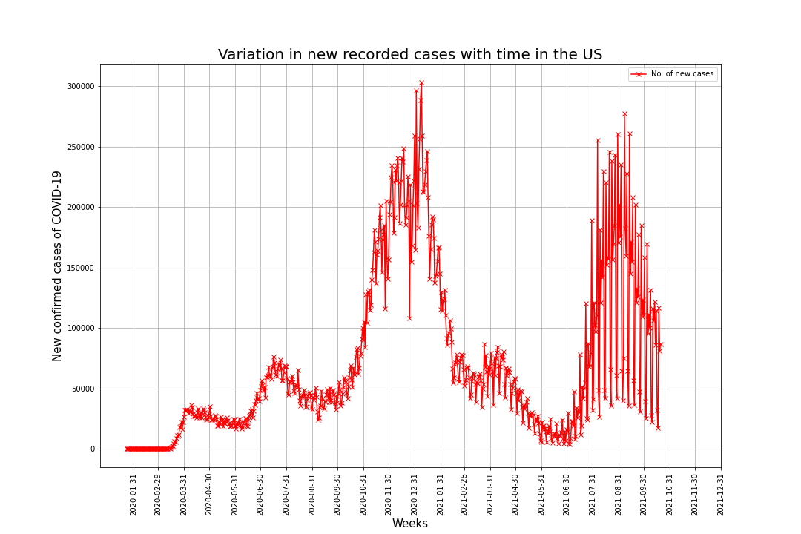
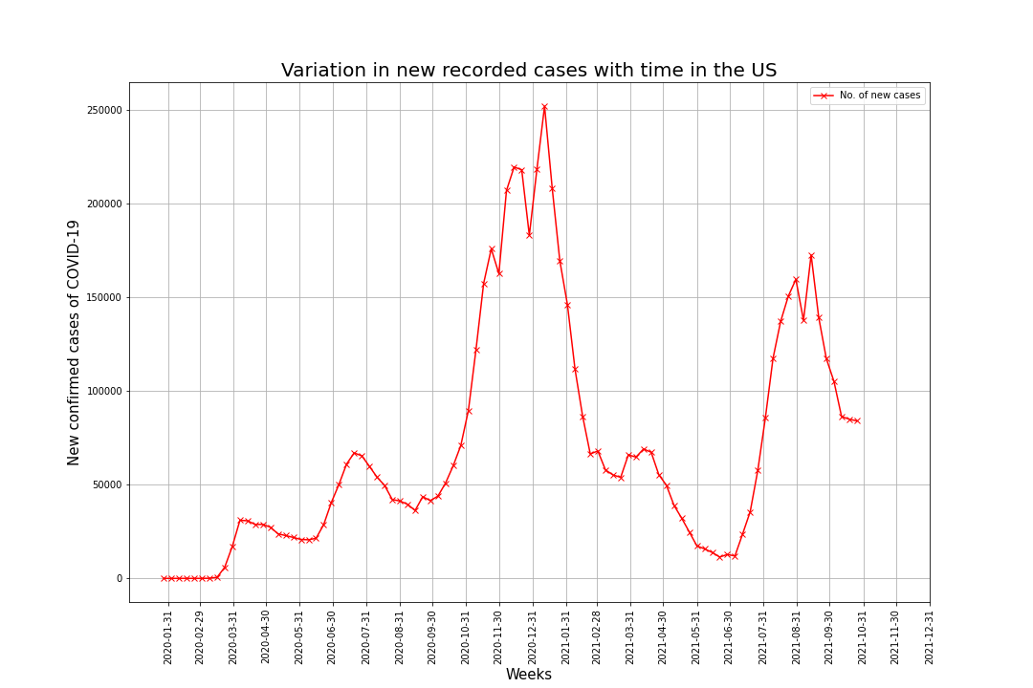
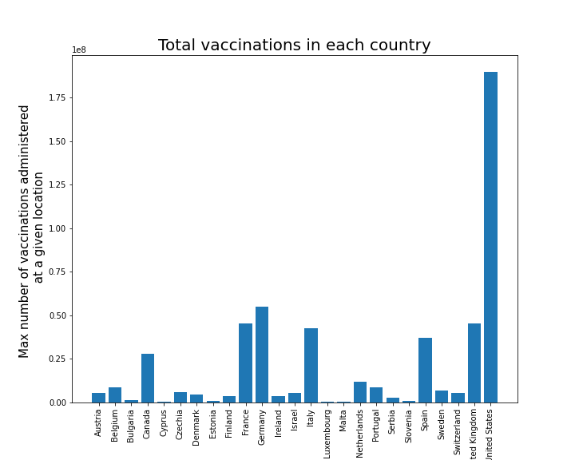
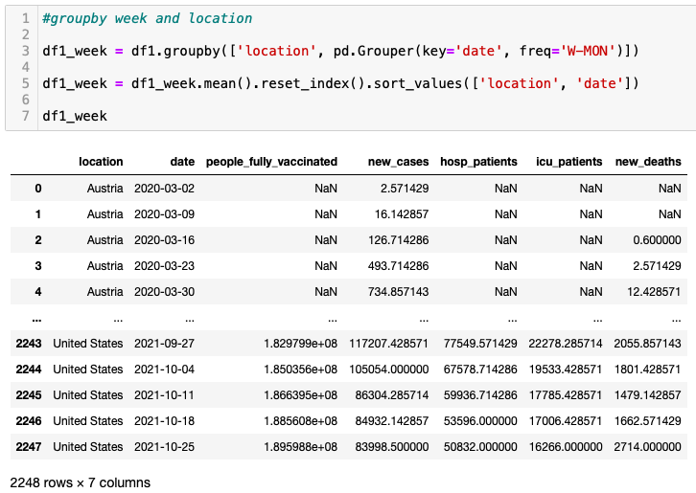
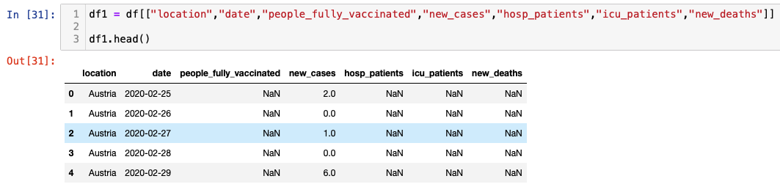
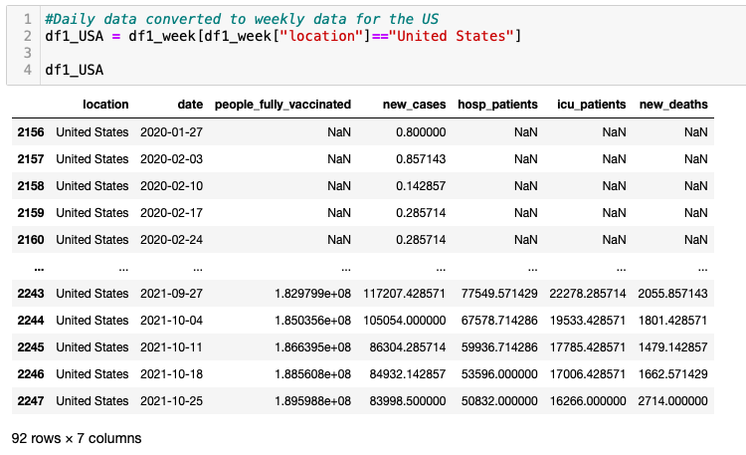
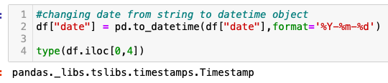
Q3: What is the relationship between vaccination rate and death, ICU and hospital admissions?
Looking for correlation between vaccinations and 4 other columns. Intent was to create time series line plot to analyze the trends.
Format string to datetime format
Hospitalisation and ICU admissions data are only available for 25 countries. As a preliminary step, bar graph plotted to visualize vaccination data available.
Presenting and analyzing each of these trends for all the countries through simple visualizations could potentially lead to misleading conclusions. Hence, a single country (United States) has been chosen as a starter.
638 rows of daily data is available for the US. To make the plot look neater and easier to interpret, the plots are plotted for weekly data points reducing down to 92 rows. This exercise is acceptable for the purpose of visualizing trends.

Slide 15
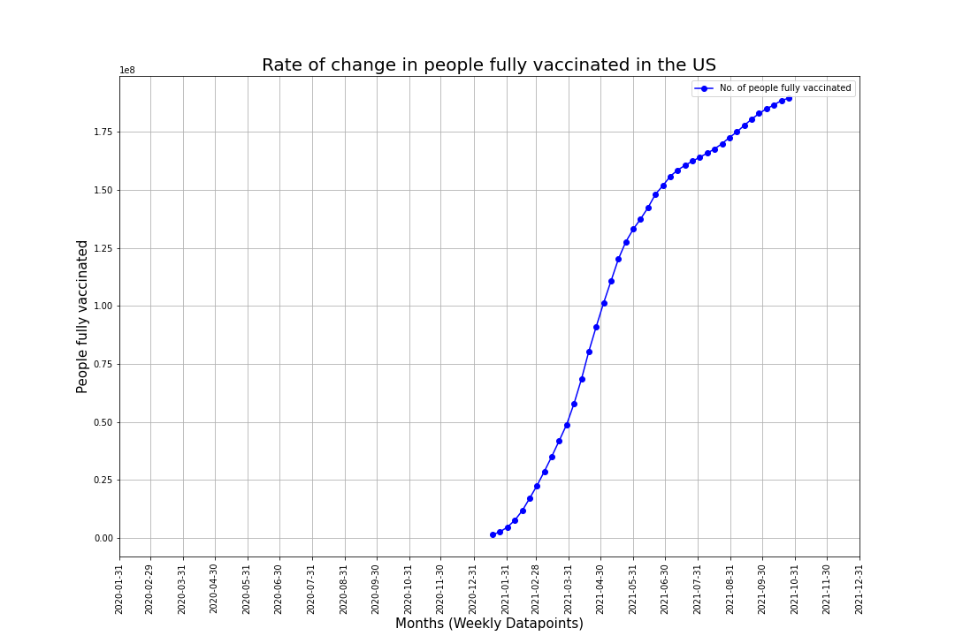
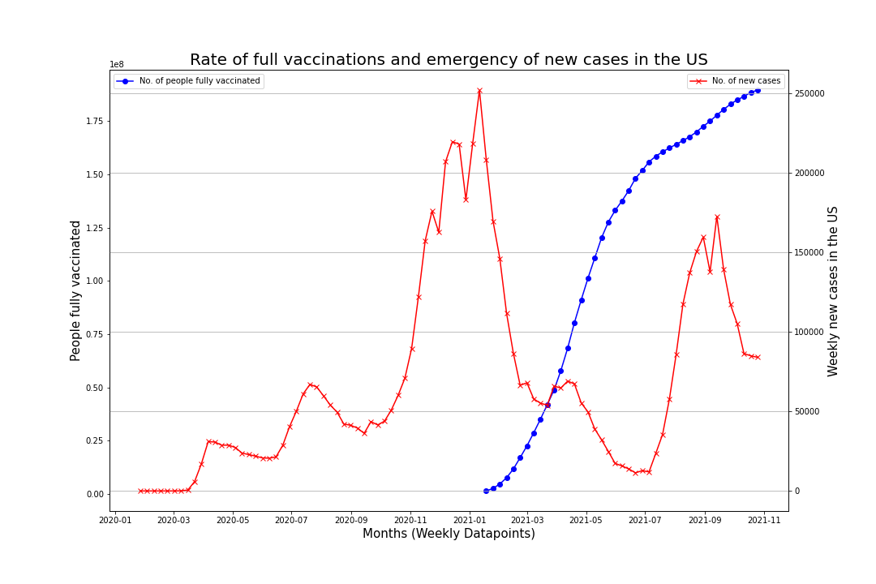
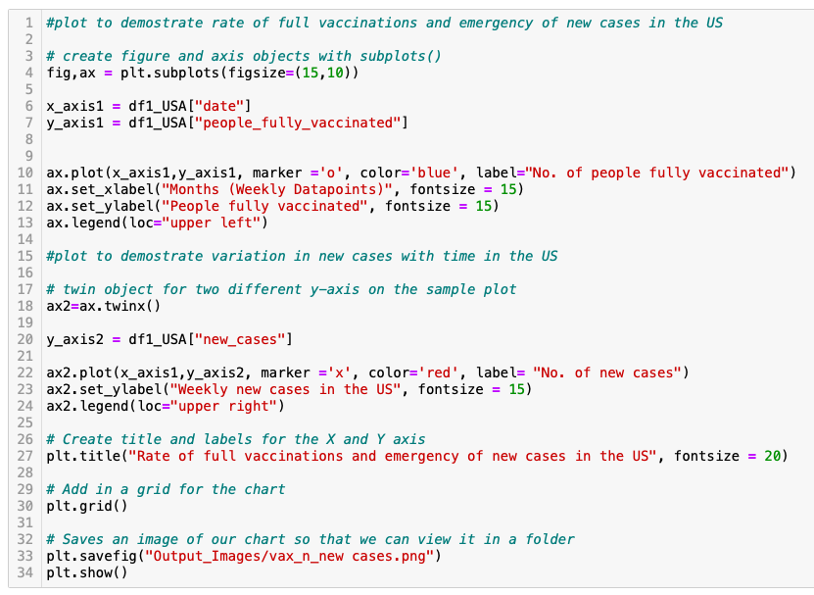
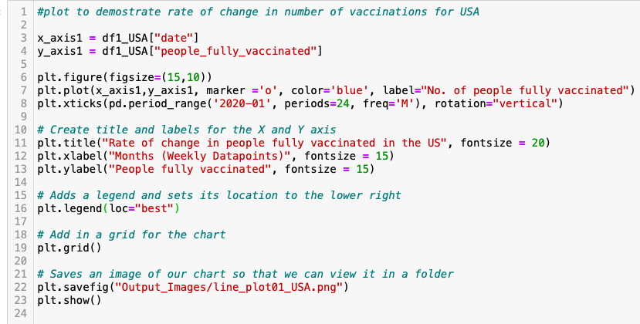
Q3: Time series plots

Slide 16
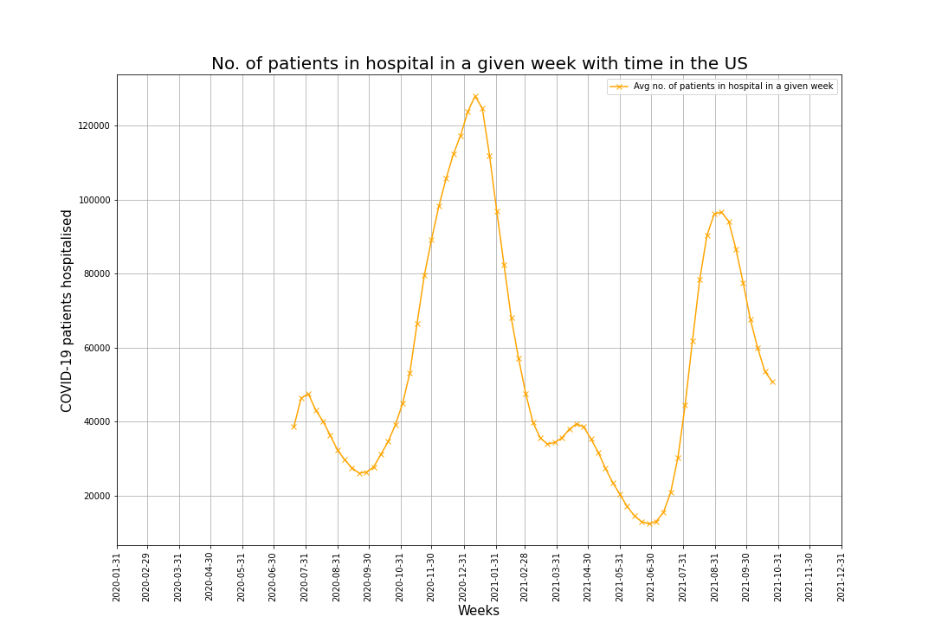
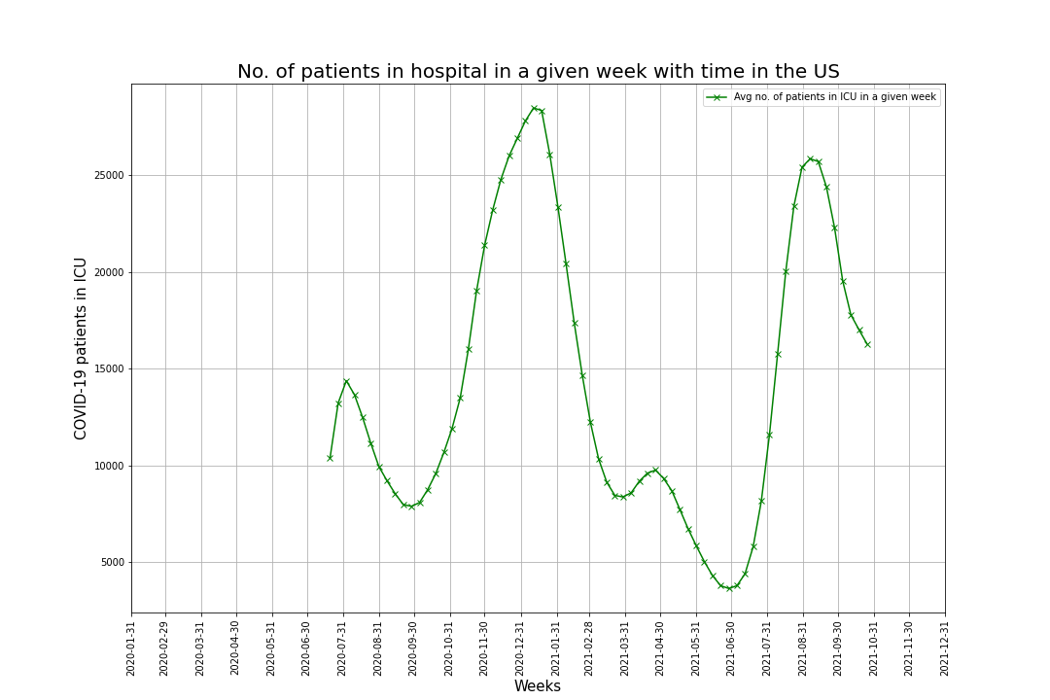
Q3: Time series plots

Slide 17
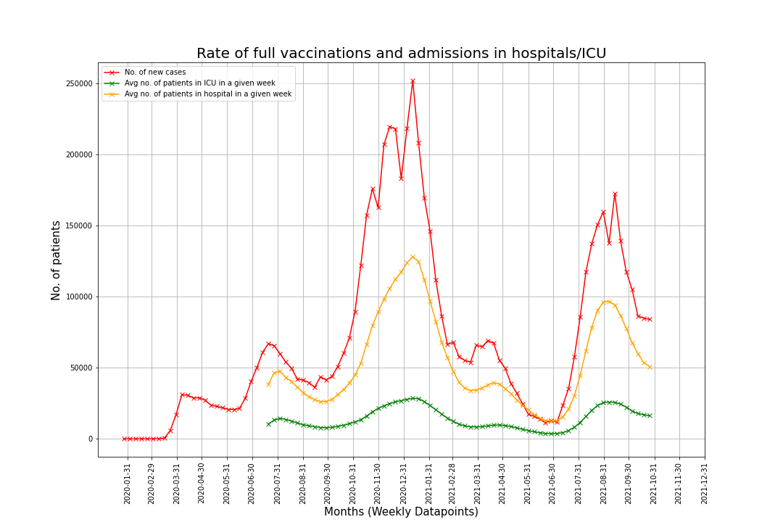
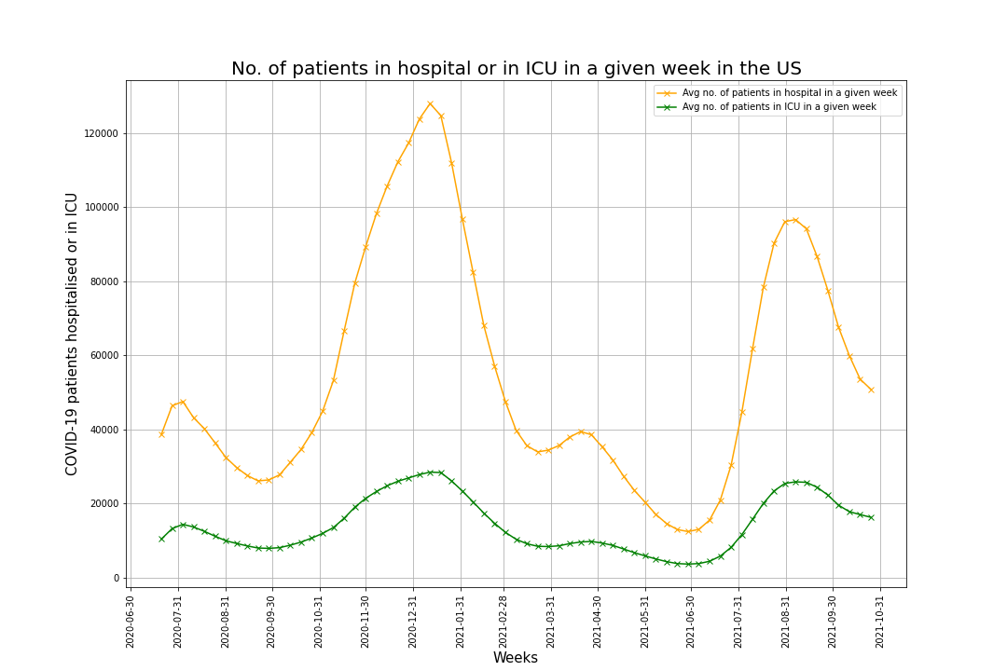
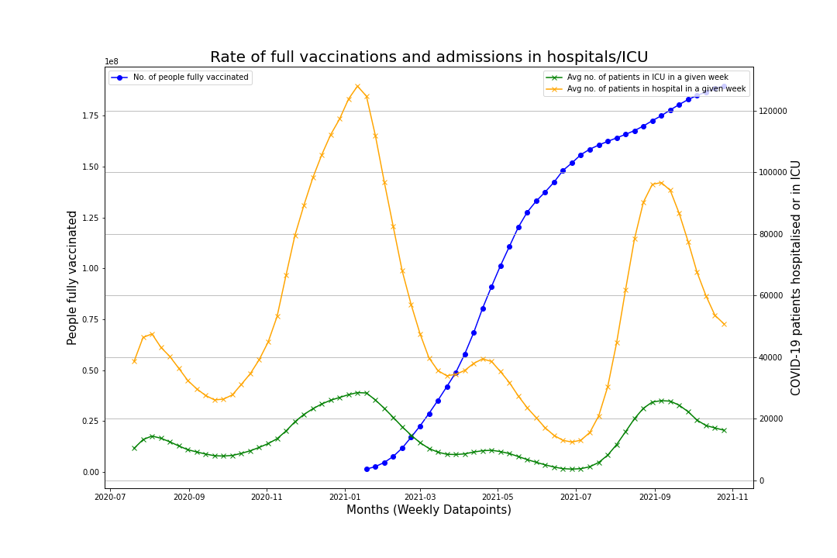
Q3: What is the relationship between vaccination rate and death, ICU and hospital admissions?

Slide 18
Q3: What is the relationship between vaccination rate and death, ICU and hospital admissions?
Findings
Similar trendlines were observed in all time series plots i.e. for new cases, hospitalization, ICU patients and deaths
Research tells that spike in cases observed from August to mid October are due to ease of lockdown and social distancing measures. Main reason being return to school, weekly cases among those aged 18-22 increased by 55% nationally.
Implication of the findings
Future work – additional questions
Explore trends in other countries, where social distancing measures were not in place. Identify lag using date time series.
Find correlation for each of the relationships in different countries for their vaccinated population

Slide 19
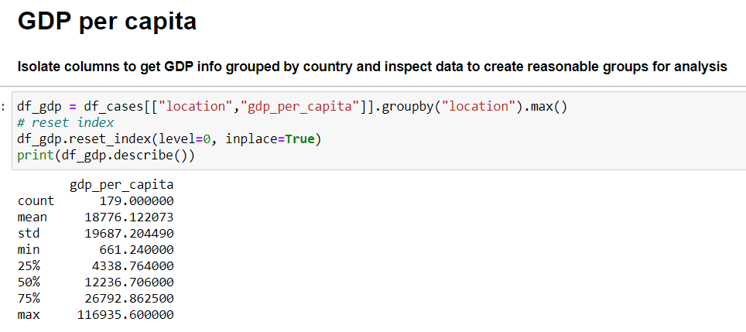
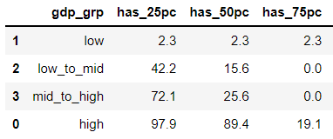
Q4: What impact does a country’s wealth have on vaccination rollout?
Created % vaccinated column
Found rows of vaccination 'milestones': 25%, 50% and 75% by country and latest %vaccinated
Summarized the data in a df for a bar chart
Created four GDP groups to categorize all countries by:
Low
Low to Mid
Mid to High
High

Slide 20
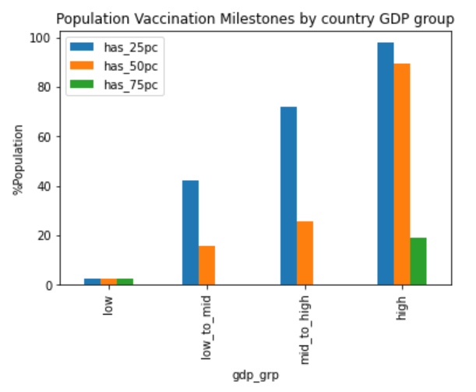
Q4: Figure 1
Our analysis showed that only 2% of countries with a low GDP per capita have reached 25% vaccination rates compared with 42% of countries with a low to mid GDP per capita, 72% of countries with a mid to high GDP per capita, and 98% of countries with high GDP per capita.

Slide 21
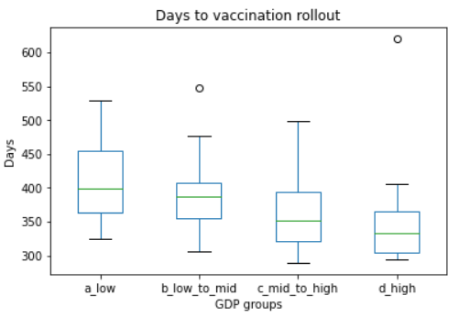
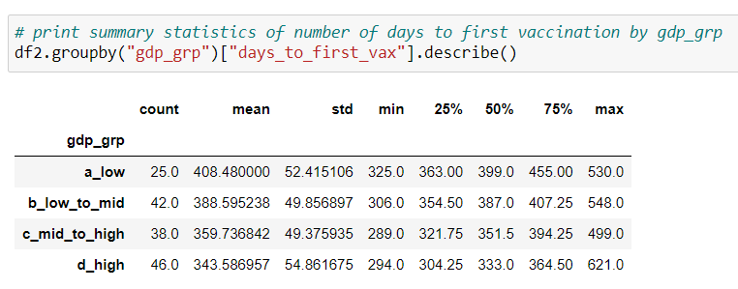
Q4: Figure 2
Retrieved first COVID-19 case start date by country
We found that a country’s wealth had a likely impact on the speed of vaccination rollout. The median number of days it took a country to start their vaccination rollout from the start of the first cases of COVID-19 was higher for countries with a low GDP per capita.
Retrieved vaccination start date by country
Calculated speed of vaccination rollout
Our analysis showed that the median (IQR) days from first COVID-19 case to first vaccination was 399 (363, 455) for low GDP per capita countries, 387 (355,407) for the low to mid group, 351 (322,394) for the mid to high group and 333 (304,365) for the high group.

Slide 22
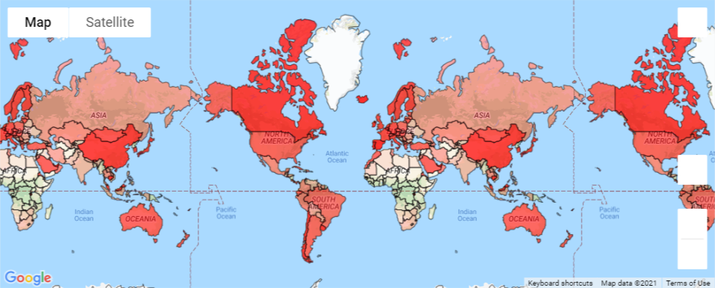
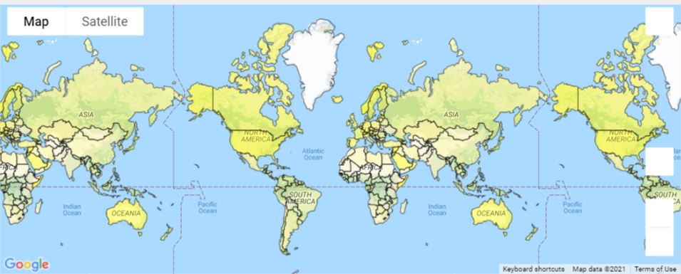
Figure 3
Fully Vaccinated per 100 people
Fully Vaccinated person and GDP
GDP per capita

Slide 23
Discussion and Conclusion
Q1: Heatmaps provided a visual representation of number of Covid-19 cases worldwide
Q2: New cases vs new deaths - High number of cases do not necessarily imply high number of deaths.
Q3: Vaccinations – Surge in no. of new cases, hospitalisation, ICU admissions and deaths is likely to be lower after vaccinations when all the restrictions are eased. Overall, the outbreak is more manageable with vaccinations.
Q4: Vaccination rollout and GDP - Further action is needed to close the gap of vaccine availability between low and high income countries. Our findings suggest that globally there is a long way to go before a significant proportion of the world’s population is vaccinated.

